Slide 1
Online Safety
Keeping children safe online at home and at school

Slide 2
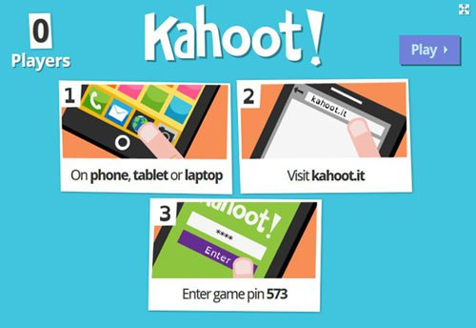
It’s Quiz Time
Enter game pin
kahoot.it
Notes:
We’ll start this off with an online quiz. This is done on Kahoot!

Slide 3
Its all about teamwork…
Here are our four steps for keeping children safe online. It's really simple. Just work as a TEAM:
Talk to your child regularly about what they are doing online
Explore their favourite sites together
Agree rules about what’s OK and what's not
Manage technology and use safety settings and controls
Notes:
Keeping children safe online is a priority at St Vincent’s. Whilst we will ensure your child is as safe as they can be at school, what they do online at home is under your control. The easiest way is to think as a TEAM. Talk regularly about what is going on in their online lives, seem interested and explore the sites/apps together. Agree some rules about what is okay – these are going to be different for everyone. Finally, managing the internet in a way that is best for you as a family is vitally important.

Slide 4
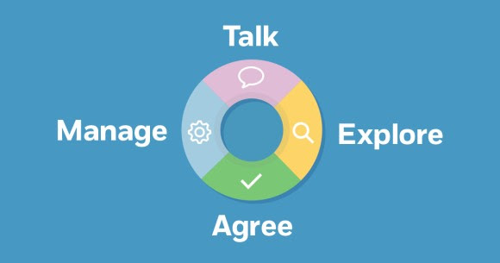

Slide 5
“We are more reliant on the internet than ever before, leaving us to sometimes question what life was like before it was launched”
NSPCC, 2017

Slide 6
Keeping Up
It's tough to keep up with all the latest apps children get into.
Lines of communication
Go with your gut
Help them learn how to use social media safely
Notes:
It's tough to keep up with all the latest apps kids get into. And the truth is, you don't have to know every single detail of how each one works. The most important thing is to keep the lines of communication open with your child. Talk about their social media, ask questions -- and listen. Pay attention to anything that sounds like a red flag and dig deeper. Helping your child learn to use social media responsibly is the most effective way to help them stay safe online.

Slide 7
What’s big at the moment?
Anonymous apps
Live streaming
Making new friends or ‘friending’
Group video chatting

Slide 8
Anonymous apps
Anonymous Apps
These apps allow users to provide anonymous, unsolicited, and unmoderated feedback to other users.
Notes:
Anonymous Apps
These apps allow children to provide anonymous, unsolicited, and unmoderated feedback to other users. Anonymous apps are notorious hubs for cyberbullying because children feel they can say things they wouldn't normally say. New apps in this category include safety precautions, but you should still keep an ear out for potential issues.
Kiwi. This app and website lets people ask questions of friends or all users. Posts are tagged with your location (unless you turn it off), so all the children at one school can be on the app

Slide 9
Live Streaming
Live Streaming
As with live TV, users simply aim the camera on themselves and broadcast to whomever is following them. Since there's no delay - and children are often streaming from their bedrooms - there's a real risk of giving away personal or even intimate information.
Notes:
Live Streaming
As with live TV, users simply aim the camera on themselves and broadcast to whomever is following them. Since there's no delay – and children are often streaming from their bedrooms -- there's a real risk of giving away personal or even intimate information. This kind of oversharing can make children vulnerable. If a child reveals too much, others can use the recordings against them.
Live.ly. Live.ly is an extension of the lip-syncing app Musical.ly -- which is known for its young users dancing suggestively. The app has no screening tools, so users who watch the streams are never entirely sure what they're going to see when they open it up. And though the terms of use clearly define what is and is not allowed, it also states that the developers have no obligation to respond to reports about violators.

Slide 10
Making New Friends
Making New Friends
The new "friending" apps enable kids to easily connect and chat with people they don't know. While many of them rely on Snapchat or Instagram, they make it very easy to widen your circle of contacts to strangers.
Notes:
Making New Friends
The new "friending" apps enable children to easily connect and chat with people they don't know. While many of them rely on Snapchat or Instagram, they make it very easy to widen your circle of contacts to strangers. Friending apps also use location, so the new "friends" are all nearby, increasing the possibility of face-to-face meetings. Privacy and safety are real risks with these apps.
Yellow. Called "Tinder for teens," Yellow works with your Snapchat or Instagram account and similarly to Tinder in that users swipe left or right on photos to find a match. Users don't have the option to make their profile private, and your profile can be viewed by anyone in a particular radius of your real-life location.

Slide 11
Making New Friends
Group Video Chatting
Group video chatting does what it says on the tin. Using their webcams or phones, kids communicate with several friends at once via live video.
Notes:
Group Video Chatting
Group video chatting is the newfangled party line from the olden days of rotary phones. Using their webcams or phones, children communicate with several friends at once via live video. Because there's no screening, there's always the possibility of children sharing private information or encountering age-inappropriate content.
Monkey. This app randomly connects users with other Snapchat users around the world for a 10-second video chat. As with so many social networking tools, a child's experience will depend a lot on other users' behaviour. Some users report abuse and requests for baring body parts, so it could be easy for some users to get into trouble with this one.

Slide 12
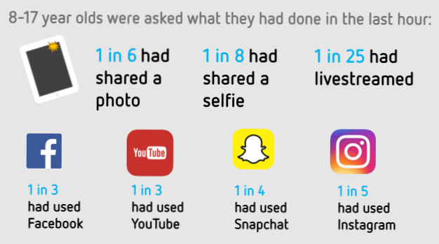
Notes:
Its really important we don’t hear this information and just think ‘well my child wouldn’t be doing that’ or ‘my children havent got any of the apps you mentioned’. When was the last time you checked what apps your child has on their iPad/what these apps allow the children to do? This infographic shocked me – it shows us just how often children are sharing information over the internet.

Slide 13
Discussion time
What are our feelings about ‘banning’ certain areas of the web?
Notes:
Discussion – points to raise:
Stops children accessing these areas provided the correct controls are put in place (e.g. web filters)
Has anyone banned their child from the computer and/or from particular sites? Your experiences
Could it push this activity underground? Ways round filters, going to friends houses or other wifi networks that are available?
Does this then almost make them want to access it?
It keeps them safe, and they understand the boundaries they are allowed.

Slide 14

Digital Footprints
When we talk to each other face to face…
It’s a bit like a footprint in the sand. Eventually the sea will wash it away
Notes:
Digital footprint (Key message about online safety for children)-When we say things face to face, whether they are kind or nasty, eventually these things will be washed over. Forgotten. However…

Slide 15

Digital Footprints
When we talk to each other online…
It’s a bit like a footprint in concrete. A record of it will stay there
forever.
Notes:
When we say things online, a record of it stays there forever. Nobody can erase it, and anyone can access it whenever they want.

Slide 16
Digital Footprints
Why does your digital footprint matter? Who is going to see your things online?
Friends
Family
Other people you know
In the future your employers
Notes:
I then ask the children, what's the problem? Well the issue is that friends see it and can hold it against you, family see it and it could be embarrassing for you or them, other people like teachers may see it and in the future your employers may well see it. It may be worth speaking to your child about their digital footprint and seeing how much they know about it. I think it’s a really good way of thinking about your online life.

Slide 17
Three instant changes
Learn how to make social media accounts secure
Discuss online life and go with your instincts
Don’t be scared of the internet
Notes:
Learning how to make your social media accounts secure is a vital part of the online world at the moment. Whether you choose to learn how to do this with your child, or decide to teach them how to do it is a hugely important skill. Having a secure social media account means your child is protected online. Their personal information cannot be seen by anyone who is not their ‘friend’ and their posts are private.
As previously mentioned, discussing online life is vital. Going with your instincts often turns out to be correct. Whilst the skills the children may be using online are different to the skills you used in your childhoods, lots of the problems they encounter have remained the same for example making friends, and therefore your instincts are usually a good judge.
It all seems a bit doom and gloom sometimes, but what people often forget is the opportunities that the internet is giving people across the globe. Children have the potential to access opportunities like never before; to learn about the world, to connect with others, to create and flourish regardless of their circumstances.

Slide 18
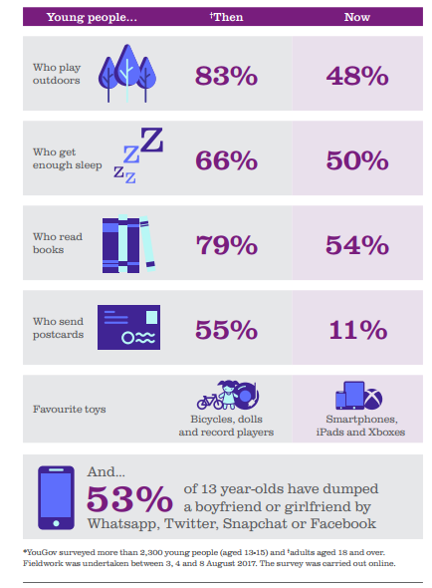
The rate of change
Notes:
This study compares the children of today with their grandparents. I find it interesting at how fast things have changed. It makes it clear in my head that parents/teachers must try to keep up with these changes to keep our children safe online, as its more than likely they will be up to date. I will leave you with this short video. After the video we will do a Q&A where I will try to answer your questions to the best of my ability! There are also some leaflets at the back which you are more than welcome to take on with you.

Slide 19

What do we do at St Vincents’s to help?
Age appropriate guidance on online safety
Updates in the on the school website
Assemblies
Children can tell us
Safer Internet Day 2019
Notes:
Give children age appropriate guidance on online safety in both Computing and PSHE lessons
We inform parents as much as possible about any online safety developments/new dangers that their child/they could face at home.
Throughout the online safety topics we talk about the importance of letting a responsible adult know what's going on, be it positive or negative. It is likely they will want to talk to you (as parents) about this but should they wish to confide in a teacher we will always listen carefully and give advice where appropriate!
This year we are putting a focus on Safer Internet Day (5th Feb), just to re-iterate the importance of keeping safe online. In Computing lessons that week the children will be making pledges to do something great and positive online.

